Slide 1
SQL Query Optimizations

Slide 2
https://www.programiz.com/sql/online-compiler/

Slide 3
Requirement For SQL Query Optimization
Enhancing Performance: The main reason for SQL Query Optimization is to reduce the response time and enhance the performance of the query. The time difference between request and response needs to be minimized for a better user experience.
Reduced Execution Time: The SQL query optimization ensures reduced CPU time hence faster results are obtained. Further, it is ensured that websites respond quickly and there are no significant lags.
Enhances the Efficiency: Query optimization reduces the time spend on hardware and thus servers run efficiently with lower power and memory consumption.

Slide 4
Use Select instead of Select *
One of the best ways to enhance efficiency is to reduce the load on the database. This can be done by limiting the amount of information to be retrieved from each query. Running queries with Select * will retrieve all the relevant information which is available in the database table. It will retrieve all the unnecessary information from the database which takes a lot of time and enhance the load on the database.
Let’s understand this better with the help of an example. Consider a table name Module which has columns names like Java, Python, and DSA.
Select * from Module; – Gives you the complete table as an output whereas
Select condition from Module; – Gives you only the preferred(selected) value

Slide 5
Use the database from last year or create new DB
Practice Using Select with column and select *
Write a short paragraph how this can optimise the query in positive and negative way ?

Slide 6
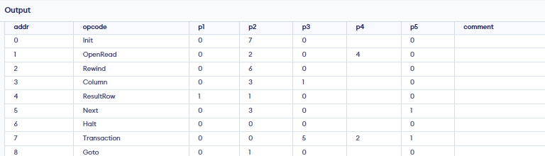
Add Explain to the Beginning of Queries
Explain keywords to describe how SQL queries are being executed. This description includes how tables are joined, their order, and many more. It is a beneficial query optimization tool that further helps in knowing the step-by-step details of execution. Add explain and check whether the changes you made have reduced the runtime significantly or not. Running Explain query takes time so it should only be done during the query optimization process.
EXPLAIN select age
from Customers

Slide 7
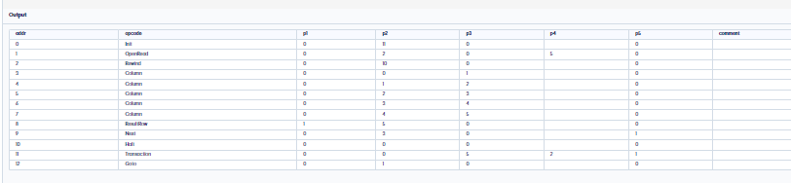
EXPLAIN select *
from Customers

Slide 8
Add Explain to the Beginning of Queries
Write a short paragraph how this can optimise the query in positive and negative way ?

Slide 9
Keep Wild cards at the End of Phrases
LIKE operator is used with where clause to search for a specified pattern. Pairing a leading wildcard with the ending wildcard will check for all records matching between the two wildcards. Let’s understand this with the help of an example.
Consider a table Employee which has 2 columns name and salary. There are 2 different employees names Roma and Balrom.
Select name, salary From Employee Where name like ‘%Rom%’;
Select name, salary From Employee Where name like ‘Rom%’;
both the cases, now when you search %Rom% you will get both the results Roma and Balrom, whereas Rom% will return just Roma. Consider this when there are multiple records of how the efficiency will be enhanced by using wild cards at the end of phrases

Slide 10
Keep Wild cards at the End of Phrases
Write a short paragraph how this can optimise the query in positive and negative way ?

Slide 11
Use Where Clause instead of having
The use of the Where clause instead of Having enhances the efficiency to a great extent. Where queries execute more quickly than having.
For Example:
SELECT name FROM table_name WHERE age>=18; – results in displaying only those names whose age is greater than or equal to 18 whereas
SELECT age COUNT(A) AS Students FROM table_name GROUP BY age HAVING COUNT(A)>1; – results in first renames the row and then displaying only those values which pass the condition

Slide 12
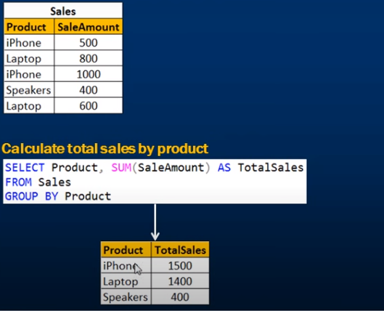
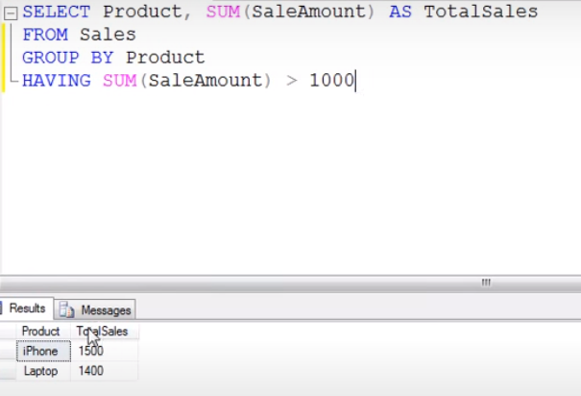
Use Where Clause instead of having

Slide 13
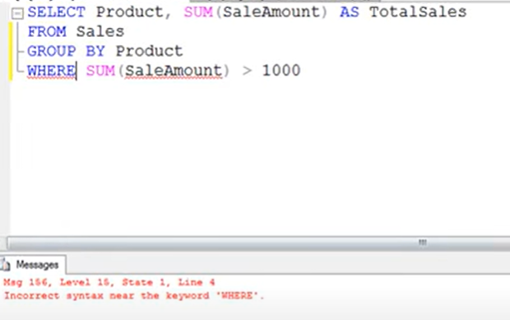
Use Where Clause instead of having

Slide 14
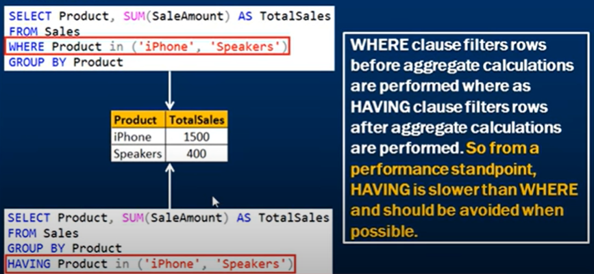
Use Where Clause instead of having

Slide 15
Use the database from last year or create new
Practice Using Where Clause instead of having
Write a short paragraph how this can optimise the query in positive and negative way ?

Slide 16
Avoid Queries inside a Loop
This is one of the best optimization techniques that you must follow. Running queries inside the loop will slow down the execution time to a great extent. In most cases, you will be able to insert and update data in bulk which is a far better approach as compared to queries inside a loop.
DECLARE @Counter INT
SET @Counter=1
WHILE ( @Counter <= 10)
BEGIN
PRINT 'The counter value is = ' + CONVERT(VARCHAR,@Counter)
SET @Counter = @Counter + 1
END

Slide 17
Loop
DECLARE @Counter INT
SET @Counter=1
WHILE ( @Counter <= 10)
BEGIN
Select name from Customers Where age= @Counter
SET @Counter = @Counter + 1
END

Slide 18
Use the database from last year or create new DB
Practice Using Loop (while - do while)
Write a short paragraph how this can optimise the query in positive and negative way ?

Slide 19
Now, you have got a clear idea of the Best Practices for SQL Query optimization.
Keep reading about Query optimization

Slide 20
Use Exist() instead of Count()
Both Exist() and Count() are used to search whether the table has a specific record or not. But in most cases Exist() is much more effective than Count(). As Exist() will run till it finds the first matching entry whereas Count() will keep on running and provide all the matching records. Hence this practice of SQL query optimization saves a lot of time and computation power. EXISTS stop as the logical test proves to be true whereas COUNT(*) must count each and every row, even after it has passed the test.

Slide 21
Use Exist() instead of Count()
Write a short paragraph how this can optimise the query in positive and negative way ?

